Slide 1
Machine Learning
Gradient Descent Algorithm
Linear Regression
Non-Linear Regression
Logistic Regression
Decision Trees
Regression Trees
Classification Trees
Model complexity and ensemble models
Clustering Algorithms
K-Means
Hierarchical clustering
DB-Scan
Mean Shift
GMM
Support Vector Machine
Deep Learning
MLP
CNN
Datasets
Breast Cancer Wisconsin
MIMIC-III
Framingham Heart Study
Alzheimer’s Disease Neuroimaging Initiative
Drug discovery
Microbiome

Slide 2
C7 – Clustering
my humble ML course

Slide 3
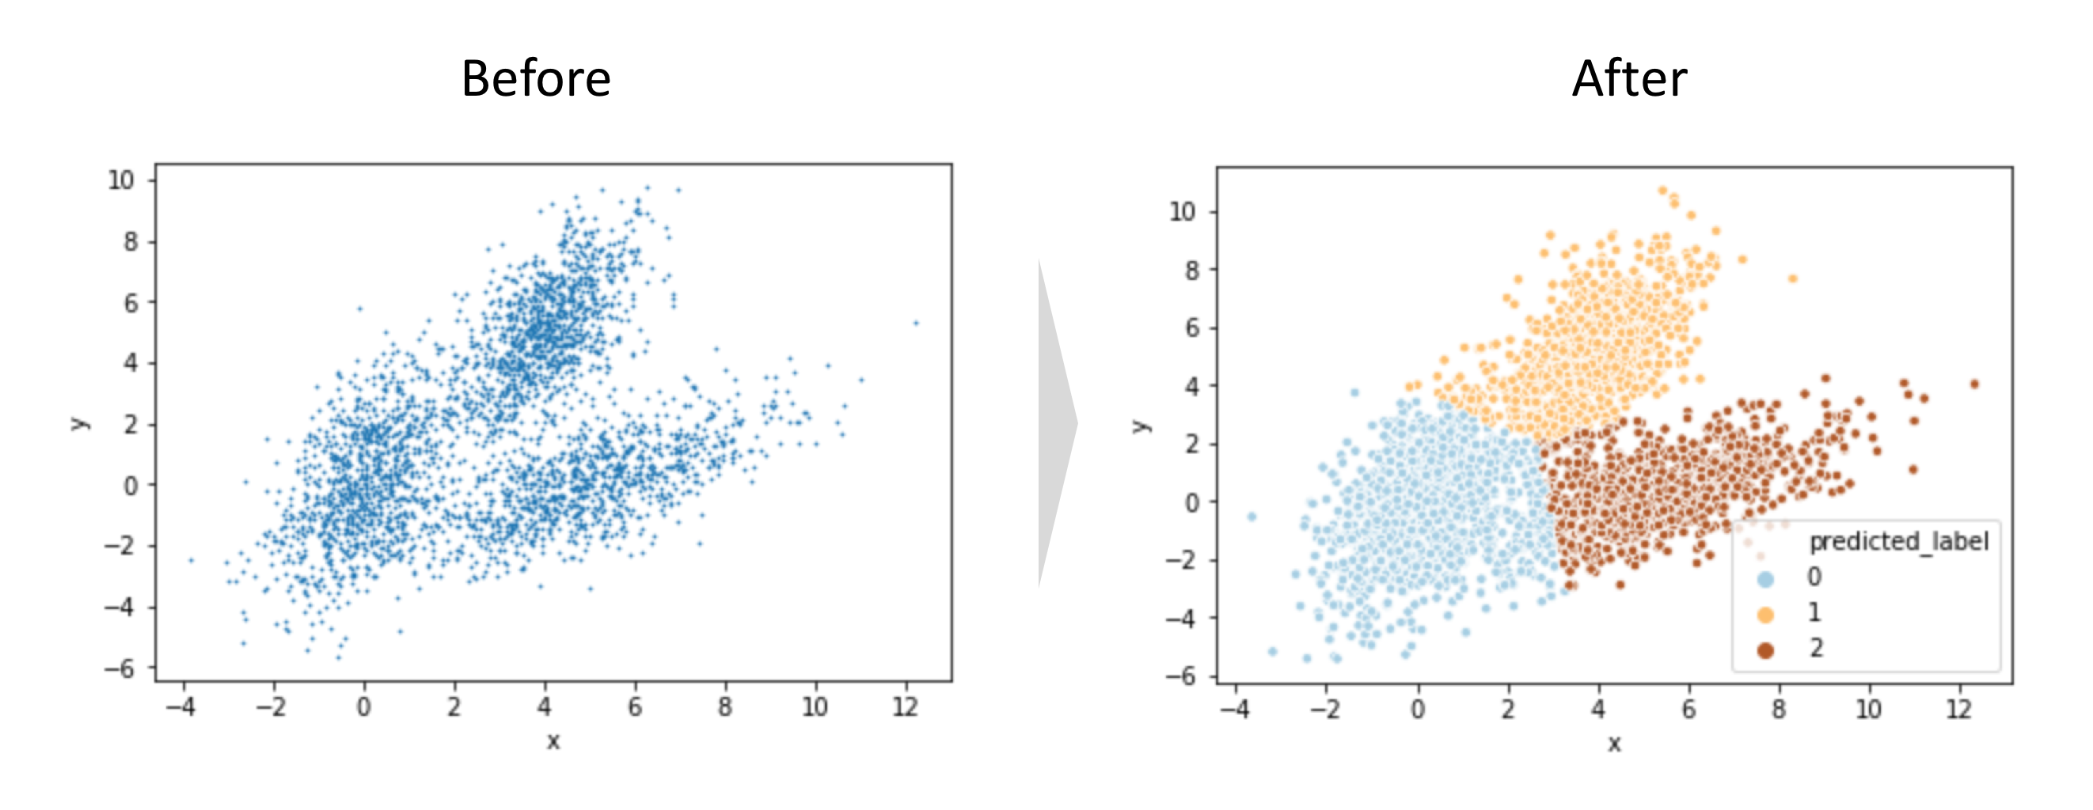
my humble ML course
Clustering
ML technique, like Regression and Classification
Unsupervised technique
Clustering is the task of dividing the data points into a number of groups such that the two data points in the same group have same features whereas two data points each in different groups contain dissimilar features. It is basically the grouping of data points based on similarity and dissimilarity.
ML technique, like Regression and Classification
Unsupervised technique
Clustering is the task of dividing the data points into a number of groups such that the two data points in the same group have same features whereas two data points each in different groups contain dissimilar features. It is basically the grouping of data points based on similarity and dissimilarity.
Notes:
El conjunto de datos que pertenecen a un mismo grupo deben tener características propiedades similares, y a la vez, características muy disímiles respecto a elementos de otros grupos
Tecnica de Machine Learning que permite agrupar, de manera no supervisada un conjunto de datos de acuerdo a su estructura o características similares.

Slide 4
my humble ML course
KMeans

Slide 5
my humble ML course
K-Means
1. Choose the number of clusters(K) and obtain the data points
2. Place the centroids c_1, c_2, ..... c_k randomly
3. Repeat steps 4 and 5 until convergence or until the end of a fixed number of iterations
4. for each data point x_i:
- find the nearest centroid(c_1, c_2 .. c_k)
- assign the point to that cluster
5. for each cluster j = 1..k
- new centroid = mean of all points assigned to that cluster
6. End

Slide 6
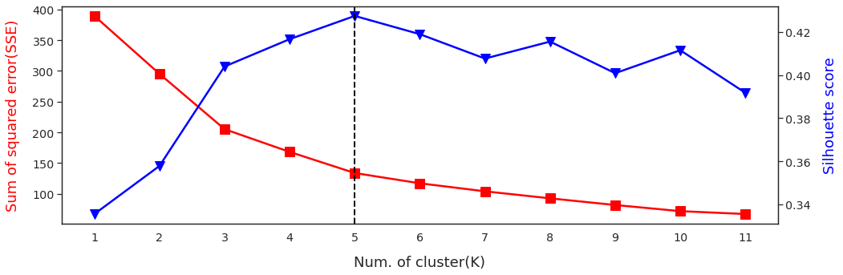
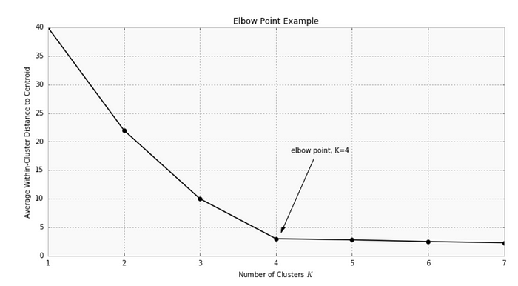
my humble ML course
KMeans
Best K? Elbow method
Centroid initialization? K-means++

Slide 7
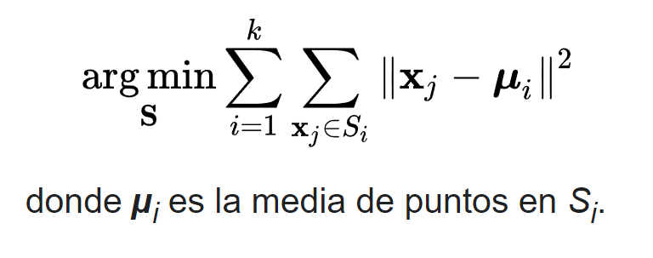
my humble ML course
WCSS (Within-cluster sums of squares)

Slide 8
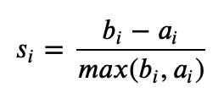
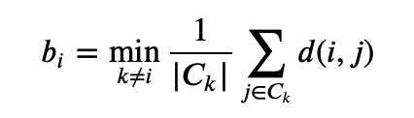
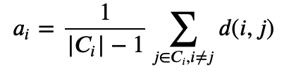
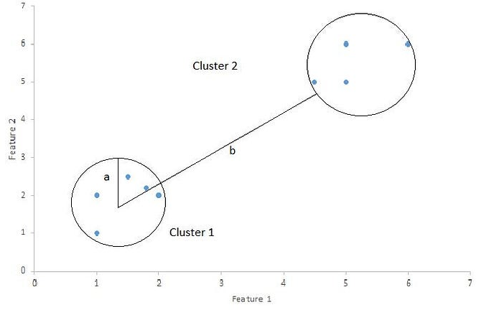
my humble ML course
Silhouette score

Slide 9
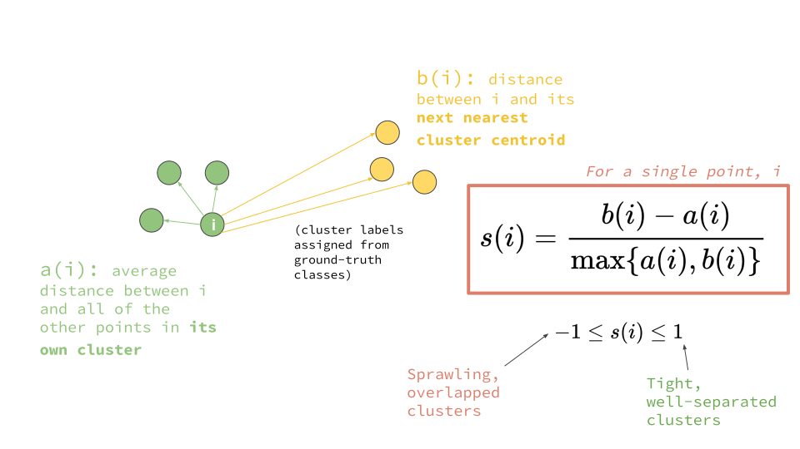
my humble ML course
Silhouette score
1: Means clusters are well apart from each other and clearly distinguished.
0: Means clusters are indifferent, or we can say that the distance between clusters is not significant.
-1: Means clusters are assigned in the wrong way.

Slide 10
my humble ML course
DBScan

Slide 11
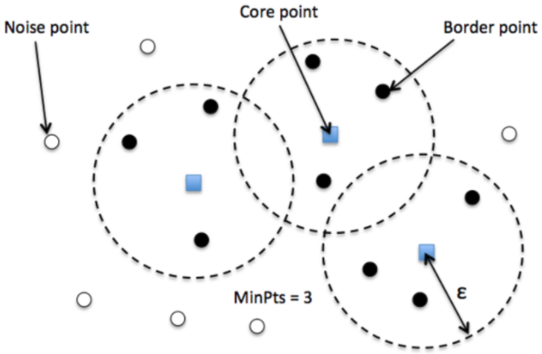
my humble ML course
DBScan
Identify distinctive groups/clusters in the data, based on the idea that a cluster in data space is a contiguous region of high point density, separated from other such clusters by contiguous regions of low point density.
2 hyperparameter:
minPts: The minimum number of points (a threshold) clustered together for a region to be considered dense.
eps (ε): A distance measure that will be used to locate the points in the neighborhood of any point.
Notes:
Core — This is a point that has at least m points within distance n from itself.
Border — This is a point that has at least one Core point at a distance n.
Noise — This is a point that is neither a Core nor a Border. And it has less than m points within distance n from itself.

Slide 12
my humble ML course
DBScan
The algorithm proceeds by arbitrarily picking up a point in the dataset (until all points have been visited).
If there are at least ‘minPoint’ points within a radius of ‘ε’ to the point then we consider all these points to be part of the same cluster.
The clusters are then expanded by recursively repeating the neighborhood calculation for each neighboring point

Slide 13
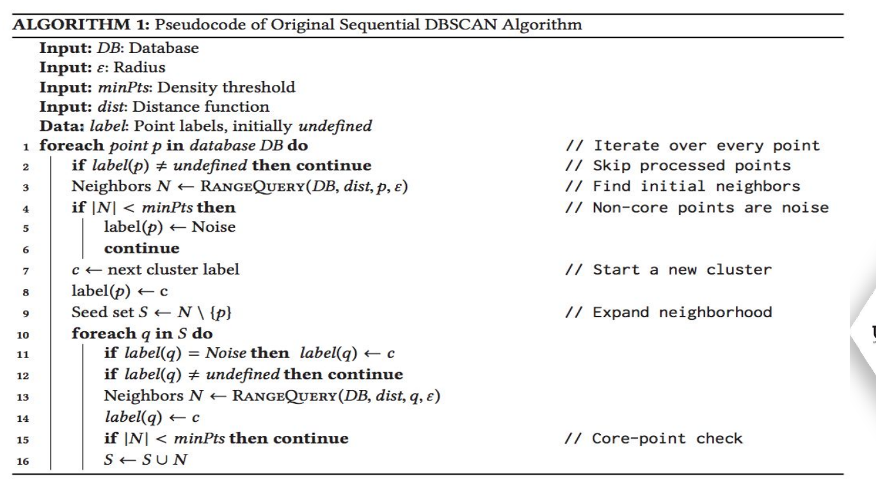
my humble ML course
DBScan

Slide 14
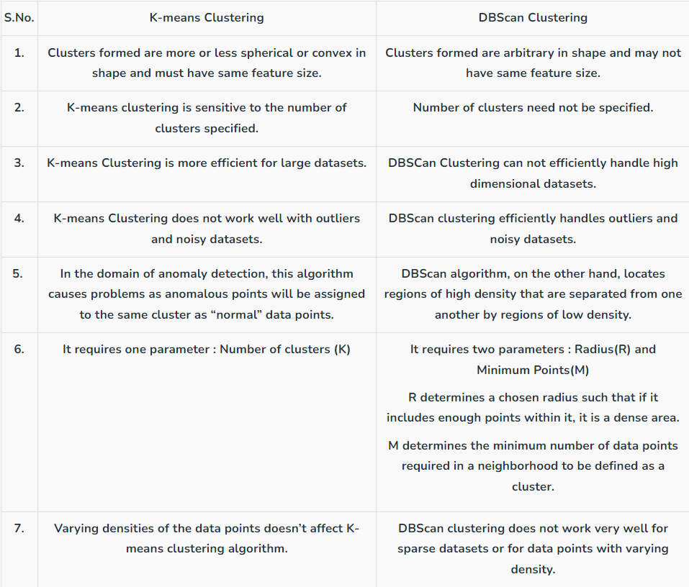
my humble ML course

Slide 15
my humble ML course
MeanShift

Slide 16
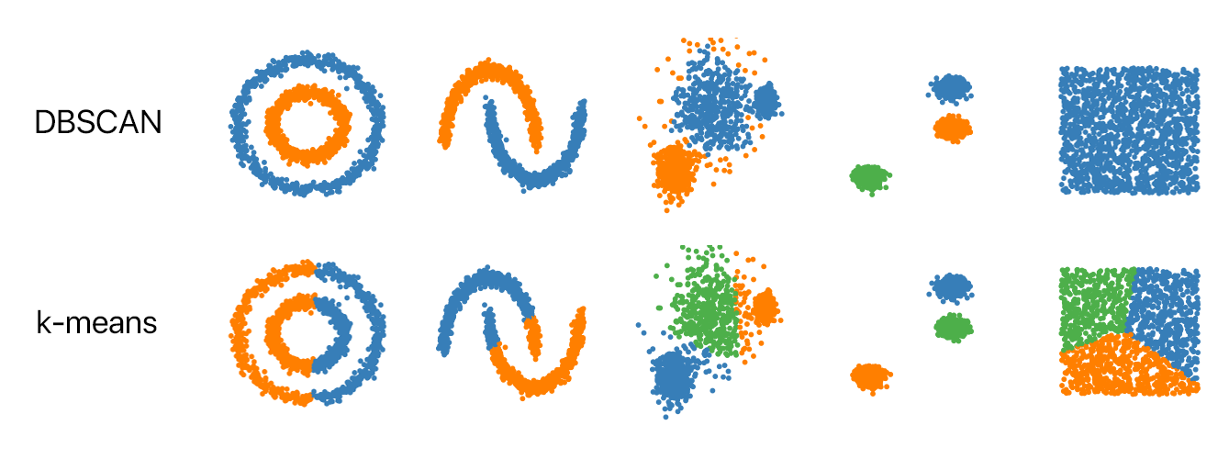
my humble ML course

Slide 17
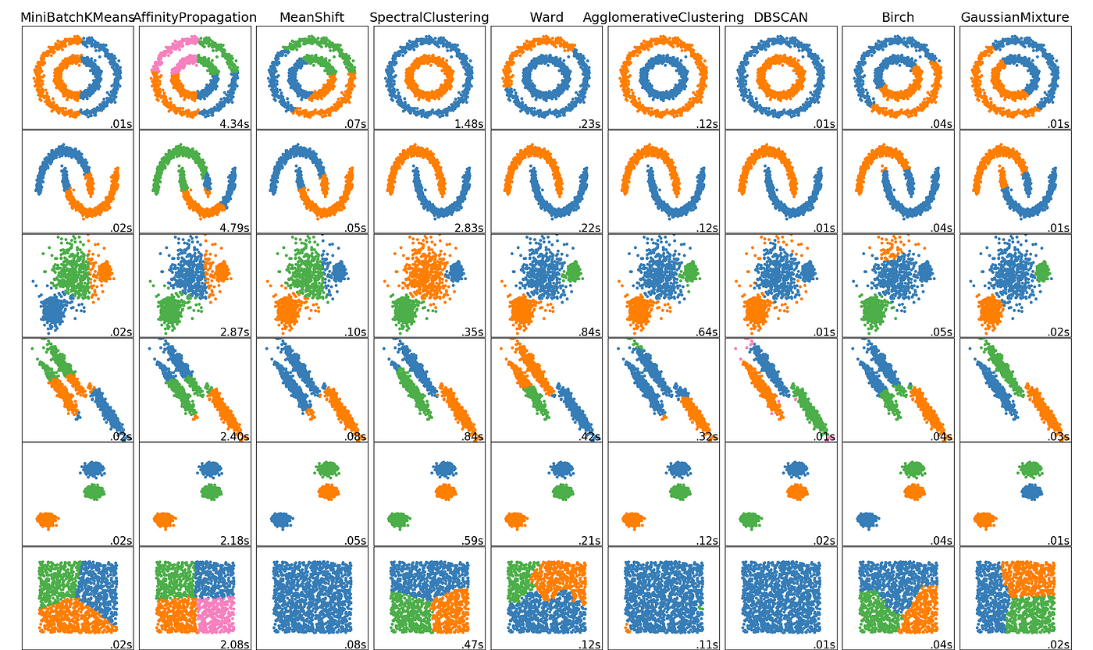
my humble ML course

Slide 18
my humble ML course
Hierarchical clustering

Slide 19
my humble ML course
Bibliography
https://github.com/jeremy-jmc/IA-P002
https://drive.google.com/drive/u/0/folders/1X3AjOQ2G7NZO3U_0KGYzPXex49vx3Iy-
https://towardsdatascience.com/k-means-clustering-introduction-to-machine-learning-algorithms-c96bf0d5d57a
https://www.kdnuggets.com/2020/04/dbscan-clustering-algorithm-machine-learning.html
https://www.kaggle.com/code/alirezahanifi/customer-segmentation-k-means-dbscan-meanshift
https://www.geeksforgeeks.org/difference-between-k-means-and-dbscan-clustering/
https://soroushhashemifar.medium.com/kmeans-vs-dbscan-d9d5f9dbee8b
https://es.wikipedia.org/wiki/Silhouette_(clustering)
https://tushar-joshi-89.medium.com/silhouette-score-a9f7d8d78f29
https://towardsdatascience.com/silhouette-coefficient-validating-clustering-techniques-e976bb81d10c
https://www.kaggle.com/code/alirezahanifi/customer-segmentation-k-means-dbscan-meanshift
https://medium.com/@ainsupriyofficial/unsupervised-learning-clustering-algorithms-fad2d86cce6a
https://towardsdatascience.com/the-5-clustering-algorithms-data-scientists-need-to-know-a36d136ef68

